Slide 1
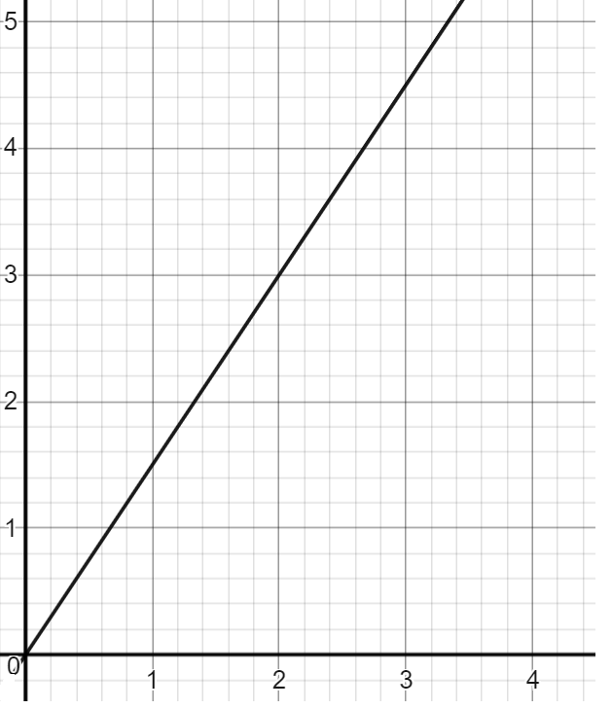
Ratio language and notation
Task A: Ratio language and notation
1) Fill in the table. The first has been done for you.
Bar model | Ratio notation | In words
 | B : H 3 : 1 | Ratio of books to hearts is 3 to 1
 | Squares : Circles
 | T : S
 | C : A : O
B | B | B | H
⬛ | ⚫ | ⚫
T | T | S | S | S
C | A | A | O | O
2) All these represent the same ratio. Fill in the blanks.
$
£ | $
12
2
£
$
£ : $
:
£

Slide 2
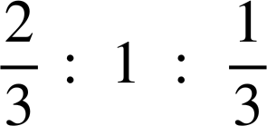
Ratio language and notation
Task A: Ratio language and notation
3) Match the ratio table with the ratio notation.
A | B
3 | 10
A | B
30 | 10
A | B
4 | 6
A | B
30 | 50
A | B
60 | 12
5 | 1
3 | 1
3 | 5
2 | 3
A : B
3 : 1
A : B
24 : 80
A : B
15 : 25
A : B
2 : 3
A : B
25 : 5
4) Work out the equivalent ratios.
: 10
: 25
2 :
4 : 5
: 0.5
: 40
1 :
5) Work out the equivalent ratios.
8 : :
: : 11
10 : :
2 : 3 : 1
: : 0.5
20 : :
‹#›

Slide 3
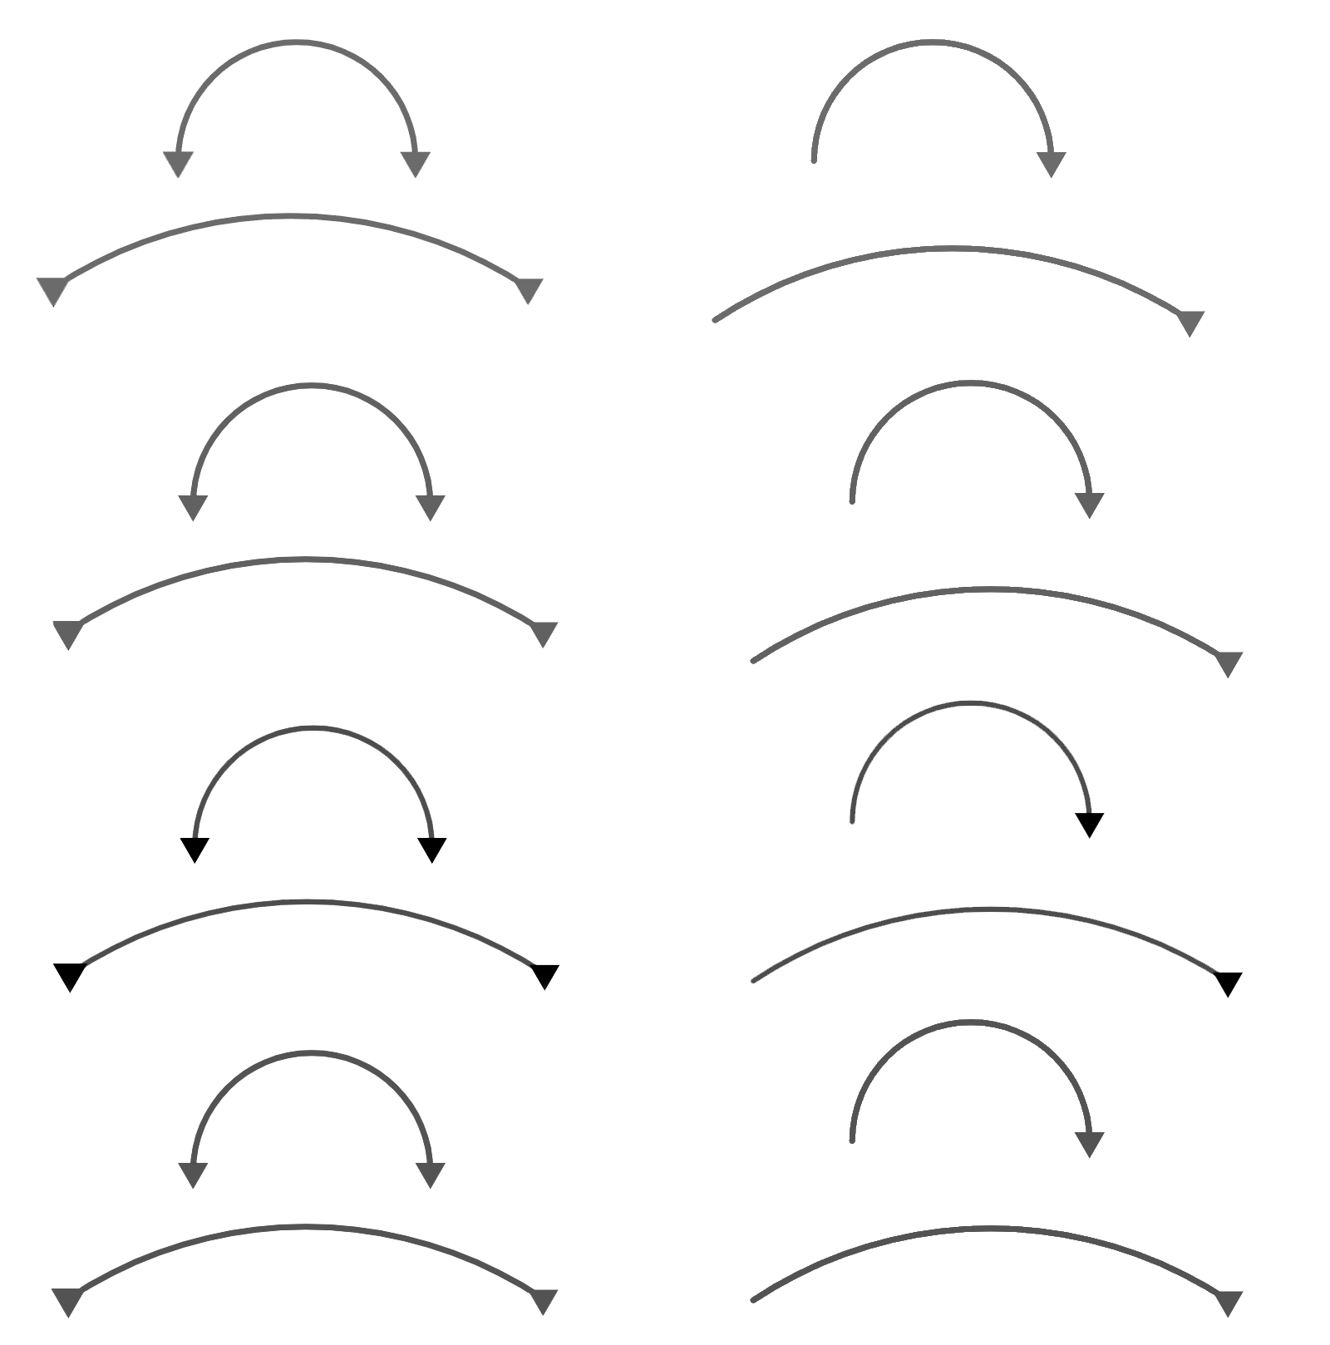

Ratio language and notation
Task B: Comparing different representations of ratio
1) Fill in the blanks to complete the work.
Cheese : Tomato
3 : 4
15 : 20
A total of 35 g means there is 15 g of cheese and 20 g of tomato.
b) Yoghurt : Strawberry
5 : 9
:
A total of ml means there is ml of yoghurt and ml of strawberries.
c) Star : Tick : Stars
2 : 3 :
: : 6
A total of shapes. There are stars, ticks and squares.
×
×
× 4
×4
× 6
×6
2) In a bag, there are only stars and circles.
The ratio of stars to circles is 2 : 3
a) If there are 20 stars, how many circles are there?
b) If there 65 shapes in total, how many stars are there?
‹#›

Slide 4

Ratio language and notation
Task B: Comparing different representations of ratio
3) The chocolates in this box either have red or blue wrappers.
The ratio of red to blue is 2 : 1
a) If there are 10 red chocolates, how many blue chocolates are there?
b) If there are 10 blue chocolates, how many red chocolates are there?
c) Is it possible for there to be 10 chocolates in total? Why or why not?
d) There are 10 more red chocolates than blue. How many are there in total?
Mathematics in Education and Industry.
v2.3

